Slide 1
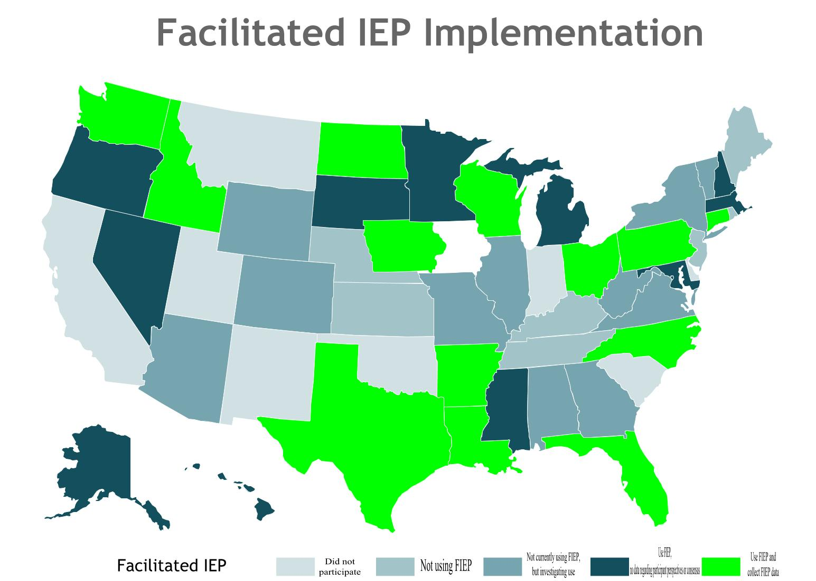
Engaging Families and Schools in Non-adversarial Conflict Resolution:
Advocacy, Facilitated-IEPs, and Procedural Safeguards
Carolyn Q. Mason
Vanderbilt University
Samantha E. Goldman
Vanderbilt University
Meghan M. Burke
University of Illinois at Urbana-Champaign
Peabody College
Overview
2. Facilitated IEPs
Results
3. Procedural Safeguards
Rationale
Families and advocates can engage proactively with schools in order to develop and monitor Individualized Education Plans (IEPs), and to obtain services and supports needed in school and the community. This presentation addresses three methods of family engagement in the special education process:
Advocacy Training
Facilitated IEP
Procedural Safeguards
When school-family communication falters, Facilitated IEP programs can provide a means for families and schools to communicate effectively and productively resolve issues. Facilitated IEP (FIEP) is offered free of charge to families in about half of states, but a recent survey indicates that this program is growing, and may be offered in as many as two-thirds of states in the next several years.
Facilitated IEP occurs at the IEP meeting, generally following conflict but before impasse. FIEP is requested when the parties agree a trained meeting facilitator would smooth communication and enhance the problem solving of the team. The trained facilitator is usually a neutral party * trained in active listening and meeting negotiation skills , who is usually contracted by the state department of education**. Where it is provided, FIEP is available a the request of families or the school system. Facilitators work to achieve meeting consensus on issues relevant to IEP development and implementation.
According to the Consortium for Alternative Dispute Resolution in Special Education (CADRE), a project of the Office of Special Education Programs , one goal of FIEP is to reduce adversarial methods of dispute resolution (CADRE, 2010, p. 7).
A second goal of FIEP identified in the literature improved family-school relationships (Balan, 2010).
*some states train school employees to actively facilitate IEP meetings.
** In some jurisdictions, FIEP services are available through parent resource centers and conflict resolution centers not connected to the state department of education.
Participants
43 State Education Agencies
Procedures
Created and beta tested survey in RedCAP
August to September 2014: called each SEA dispute resolution contact, explained survey, and asked for participation
E-mailed survey
Followed up with phone calls and e-mail reminders
Seven states did not participate
Response to survey items:
Sometimes. non-adversarial methods of advocacy and engagement fail. When they do, families can invoke the procedural safeguards provision of IDEA
Compared to families of students with other types of disabilities, families of students with ASD are significantly more likely to file for mediation or due process.
Research question:
Among families of students with ASD, what parent-school, child, and parent characteristics relate to the enactment of procedural safeguards?
Participants and Procedures
507 parents of students with ASD
Respondents from 47 of 50 states
National web-based survey in RedCAP
Hypothesized predictors of enacting procedural safeguards:
Parent-school relationship variables:
Family professional partnership
Parent advocacy
Student variables
Age
Degree of functional abilities
Degree of inclusion
Parent variable:
Household income
Analysis: Multivariate logistic regression
Results: The model was significant,
X² (9, N = 507) = 118.35, p < .0001
Discussion
Parent-school relationship predictors: Families who advocated more and had weak family-school partnerships were significantly more likely to file for due process or mediation
Student characteristic predictors: Parents were significantly more likely to enact procedural safeguards if their children were older, experienced more internalizing behaviors, and were educated in segregated placements.
Parent characteristic predictors: Parents with greater household income were more likely to enact their procedural safeguards.
For more information contact Meghanbm@illinois.edu or Samantha.Goldman@Vanderbilt.edu
1. Advocacy Training
Types of participant feedback data collected:
First, families can engage with advocacy training programs.
The Volunteer Advocacy Project (VAP) at Vanderbilt University trains volunteer special education advocates in a 40-hr workshop format. Participants agree to volunteer as an advocate for four families in their communities after graduation. This training in offered in-person or via webcast to satellite sites across the state of TN.
Purpose: To evaluate the efficacy of the VAP training in increasing special education knowledge and advocacy skills.
Participants
90 VAP graduates (out of 165)
From 33 of Tennessee’s 95 counties
59% parent of an child with disabilities
40% professionals in the disability field
Procedures
Pre-test completed before training
Post-test completed the last day of training
30 multiple choice questions about special education knowledge
10 questions about advocacy skills answered on a scale from 1 (not at all) to 5 (excellent)
Results
Discussion
The VAP training significantly improved participants’ special education knowledge and advocacy skill. Future research should examine the long-term advocacy of program graduates in addition to comparing difference dosages of advocacy trainings.
For more information contact Meghanbm@illinois.edu or Samantha.Goldman@Vanderbilt.edu
Method
Discussion
Conclusions
25 out of 43 states that responded to survey are using FIEP.
Of the 19 states that responded to our survey not currently using FIEP, 12 are considering it.
23 of 25 states keep track of the number of FIEP requests received and completed.
The majority of states (13) that use FIEP collect data regarding those that reach full consensus, no consensus and partial consensus.
Seven out of 23 states reported that they collected data on the parent-school relationship following FIEP
Five states collect follow up data from participants in the period following FIEP on factors related to the family-school relationship.
Future Directions:
What will the data tell us about how FIEP correlates with dispute resolution mechanisms under IDEA?
Request data regarding the number of FIEPs requested and completed each year, and run analyses correlating these data with publicly available dispute resolution data for each year (state complaint, mediation, due process).
Request data regarding the number of FIEPs resolving in full consensus and run analyses correlating these data with publicly available dispute resolution data for each year (state complaint, mediation, due process).
What do participants tell us about whether FIEP improves the parent-school relationship?
Request data regarding participant perspectives on the family school relationship following FIEP
Request data regarding participant perspectives on the family school communication following FIEP
Request follow-up data regarding participant perspectives on the family school relationship following FIEP
For more information, contact carolyn.q.mason@vanderbilt.edu
Predictors | B | SE | Wald | p | OR [95% CI]
Advocacy | 0.12 | .02 | 35.31 | .000 | 1.13 [1.08, 1.17]
Family Subscale | -0.06 | .01 | 19.17 | .000 | 0.94 [0.91, 0.96]
Income (reference: $100,000 and over)
Below $15,000 | -0.27 | .72 | 0.15 | .703 | 0.76 [0.19, 3.11]
$15,000-$29,999 | -1.07 | .51 | 4.30 | .038 | 0.34 [0.13, 0.94]
$30,000-$49,999 | -0.84 | .38 | 5.05 | .025 | 0.43 [0.21, 0.89]
$50,000-$69,999 | -0.71 | .37 | 3.69 | .055 | 0.49 [0.24, 1.01]
$70,000-$99,999 | -0.50 | .31 | 2.60 | .107 | 0.61 [0.33, 1.11]
Child Age | 0.03 | .02 | 3.57 | .005 | 1.03 [1.02, 1.14]
Gen Ed. Placement (reference: 81-100%)
0-20% | 0.65 | .28 | 5.49 | .019 | 1.92 [1.10, 3.31]
21-40% | -0.13 | .59 | 0.05 | .823 | 0.88 [0.28, 2.77]
41-60% | 0.07 | .49 | 0.02 | .891 | 1.07 [0.41, 2.81]
61-80% | -0.02 | .45 | 0.002 | .969 | 0.98 [0.96, 1.00]
Internalizing behav. | 0.03 | .01 | 4.99 | .025 | 1.03 [1.00, 1.06]
Asocial behaviors | -0.02 | .01 | 2.80 | .095 | 0.98 [0.96, 1.00]
Externalizing behav. | -0.01 | .01 | 0.16 | .898 | 0.99 [0.97, 1.02]
FIEP Implementation across the United States
Measures
Web-based RedCAP Survey
Created to discover which states were using FIEP
Collected information on:
When FIEP is implemented
If not, if the SEA is considering implementation of FIEP.
If implemented, when
SEA satisfaction with FIEP
Data collected by the SEA on FIEP implementation
.
 | Pre-test M (SD) | Post-test M (SD) | t | p
Special Ed Knowledge | 14.90 (3.59) | 23.32 (3.58) | -16.90 | <.001
Advocacy Skills | 32.82 (6.91) | 40.97 (5.42) | -9.74 | <.001

